Slide 1

Predicting Total Loss
Team deepCrash
Huseyin Burak Akyol
Anna Jiang
Yicheng Li
Ulas Baran Baloglu
Raul Richard Stein

Slide 2
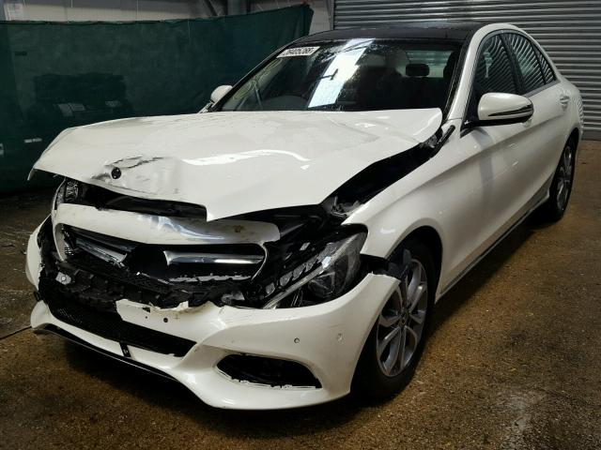
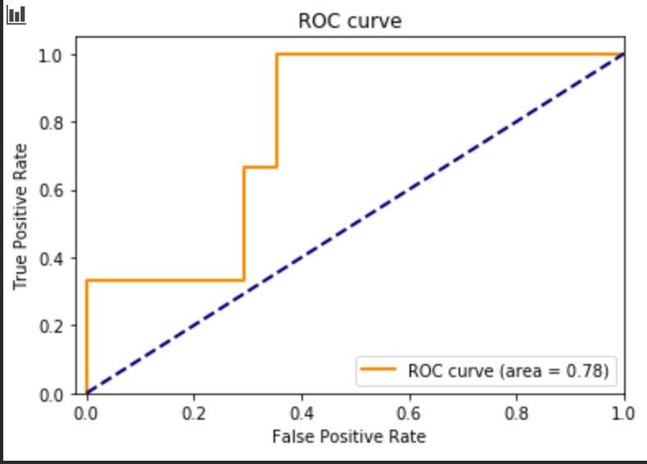
The Solution
Predict Total Loss with XGBoost or RNN –Accuracy on sample dataset~80%
Map words in comments to vectors and calculate correlation with „Total loss
Implement a CNN to classify regions of damage on cars
Normalise images and calculate pixels with recognized damage
Feed back to decision tree to make a better decision

Slide 3
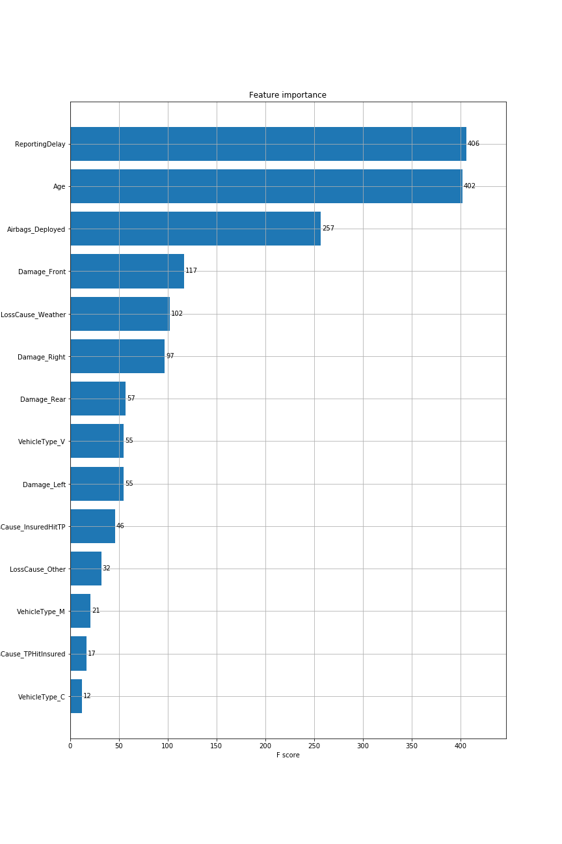
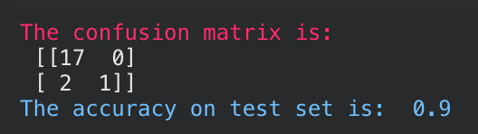

Slide 4
Data processing
Convert variables to numeric values
Replace NaN in damages with False
Group parameters (such as age of car) by considering the weight of evidence.
Feature engineering: Time between incident and claim being made
Investigate correlations in data

Slide 5
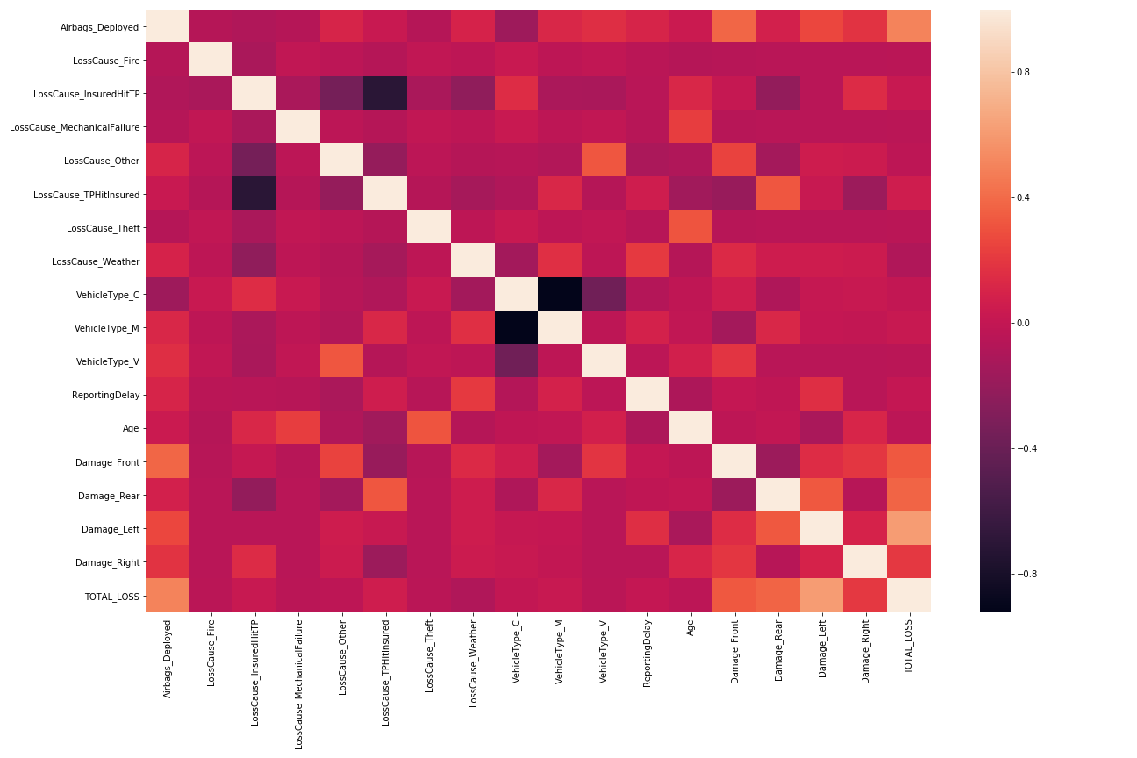
Correlations
Airbags deployed?
Damages? Especially in the left for some reason (60% correlation)?
Weather?

Slide 6
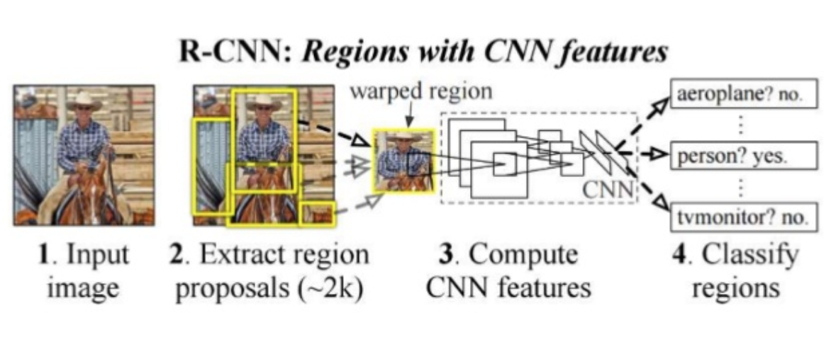
Future work

Slide 7
Thank you for listening!

